Slide 1

Automotive Inventory Management System
Team Members: Venkatesh Punugoti
Gautam
Chandan R
Mentor: Shiva Prasad B S
Bharathi Gnanamurthy
Arthi Thapar
Jennifer Arcidiacono

Slide 2




Team
Gautam Kumar
Associate Software Engineer | CGI
MIG (MFG)
Bengaluru, Karnataka
Chandan R
Associate Software Engineer | CGI
Venkatesh Punugoti
Apprentice | CGI
MIG (TRL)
Bengaluru, Karnataka

Slide 3

Table of Contents
Introduction
Business Problem
Proposed Solution
System Architecture
Database Design (ERD)
Implementation
Solution Snapshots
Challenges & Solutions
Q&A

Slide 4
Introduction
Overview: A Business Intelligence (BI) solution designed for AutoTech Manufacturing to improve supply chain visibility and efficiency.
Objectives:
Manage inventory across multiple plants
Track supplier performance and reliability
Enable real-time, data-driven decision making
Scope:
Inventory tracking and optimization
Supplier performance monitoring
Executive dashboards & operational reports
Automated alerts for exceptions

Slide 5
Business Problem
Inventory Issues: Stock-outs in some plants, overstock in others
Supplier Problems: Unclear delivery performance & quality
Decision Making: Lack of real-time insights
Cost Control: High carrying costs due to excess stock

Slide 6
Proposed Solution
Real-time Inventory Visibility across all plants
Supplier Performance Tracking with ratings & delays
Automated Last_Movement_Date
Automated Alerts Report when stock < reorder level
Dashboards & Reports for executives and operations

Slide 7
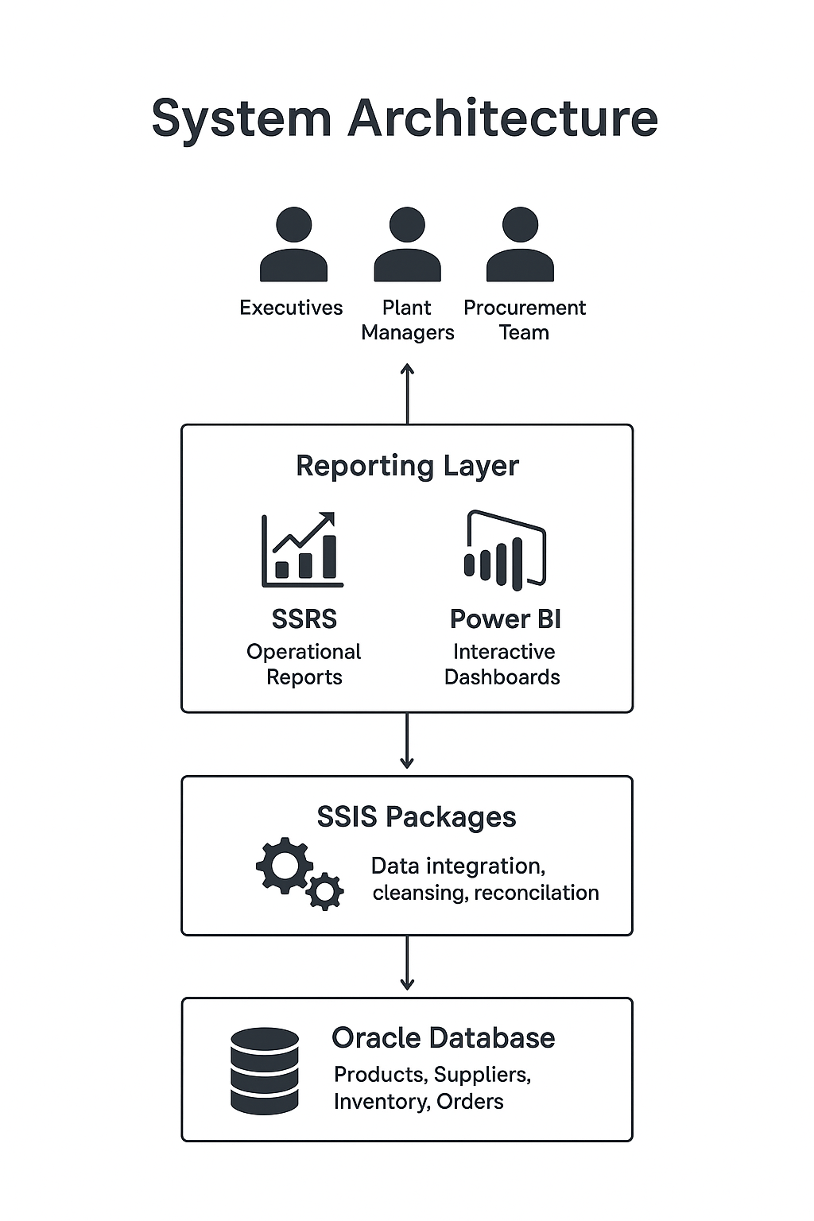
System Architecture
Data Layer: Oracle DB (Products, Suppliers, Inventory, Orders)
ETL Layer: SSIS (integration, cleansing, reconciliation)
Reporting Layer: SSRS (reports), Power BI (dashboards)
Users: Executives, Plant Managers, Procurement

Slide 8
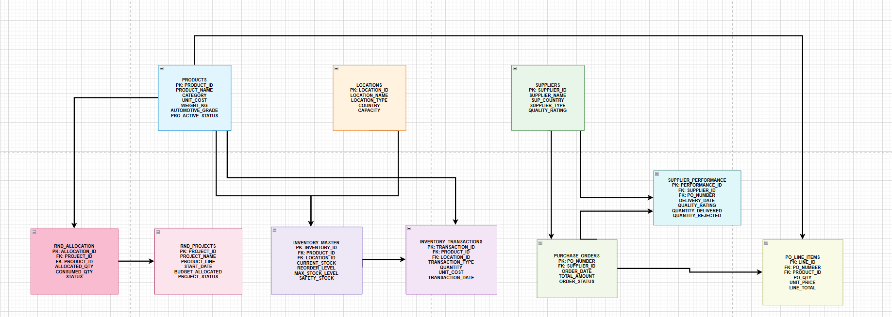
Database Design (ERD)
1
1
1
1
1
1
1
M
M
M
M
1
M
M
←
M
1
1
M
1
M

Slide 9
Implementation

Slide 10

🚚 Stock Transfer Procedure (PL/SQL)
Purpose
Key Steps
Error Handling
-20001 → Same From & To location
-20002 → Invalid quantity
-20003 → Insufficient stock
-20007 / -20008 → Product missing at location
-20006 → Unexpected error
• Automates product stock movement between locations.
• Ensures integrity, validation, and audit tracking.
1. Generate unique Transfer ID (TR000001…) using sequence
2. Validate inputs:
- Source ≠ Destination location
- Quantity > 0
- Product exists at both locations
- Sufficient stock at source
3. Update inventory:
- Deduct from source
- Add to destination
4. Insert record into STOCK_TRANSFERS table
5. Commit transaction

Slide 11
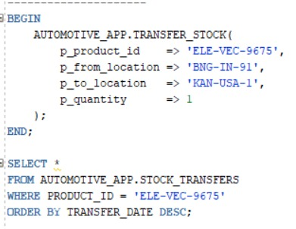
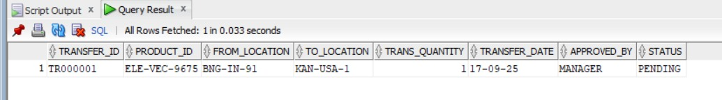
Block:
Invoke:
Output:

Slide 12
📊 Function: Fn_SUPPLIER_PERFORMANCE
Purpose
Logic Flow
Error Handling
Computes overall performance score for a supplier.
Returns weighted rating on a scale of 0–5.
Validate supplier ID (must not be NULL).
Fetch average quality rating from SUPPLIER_PERFORMANCE.
Get delivered vs. rejected quantities.
Compute delivery rating = ((Qty_Delivered – Qty_Rejected) ÷ Qty_Delivered) × 5
Calculate final score = (Quality_Rating × QualityWeight) + (Qty_Delivery × DeliveryWeight).
Normalize result between 0–5 rating.
Return score (rounded to 2 decimals).
ex_invalid_supplier → Supplier ID is NULL
NO_DATA_FOUND → No records for supplier
VALUE_ERROR → Invalid numeric values
OTHERS → Unexpected errors,

Slide 13

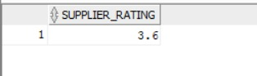
Function :
Test:
Output:

Slide 14
Trigger: Update Last Movement Date
Type: BEFORE UPDATE row-level trigger
Purpose
Logic Flow
Automatically updates the column last_movement_date whenever either current_stock or unit_cost in inventory_master is updated.
Ensures that the table always reflects the latest stock/cost modification timestamp.
Trigger fires before update on inventory_master.
If either current_stock or unit_cost is modified →System sets :NEW.last_movement_date = SYSDATE.
Exception handling:Captures any error via SQLERRM.Raises an application error with code -20001 for debugging.

Slide 15
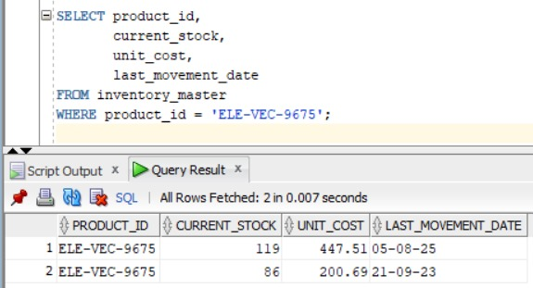
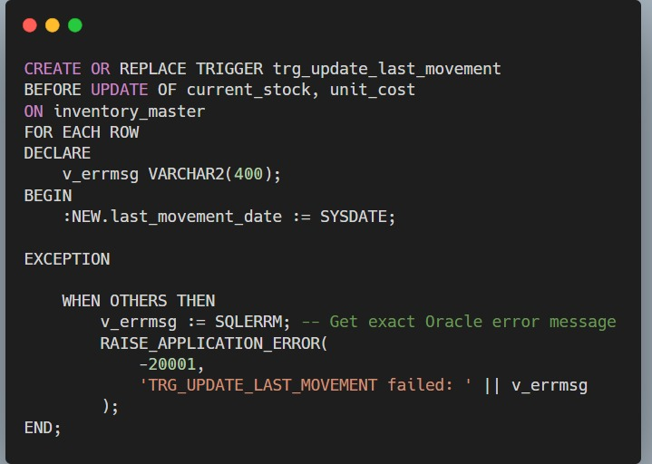
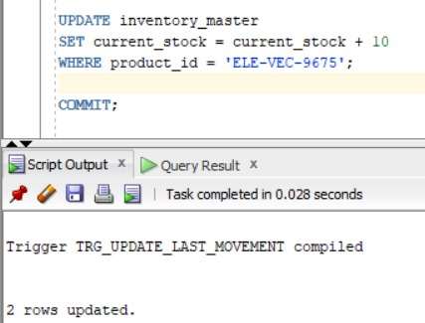
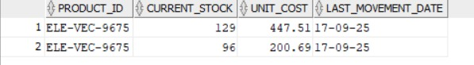
Code:
Output:

Slide 16
SSIS: Build Supplier Data Integration
Automates import of supplier delivery data from CSV files
Validates and cleanses data for accuracy and consistency
Ensures only valid data is loaded into destination
Logs errors and invalid rows for auditing and review

Slide 17
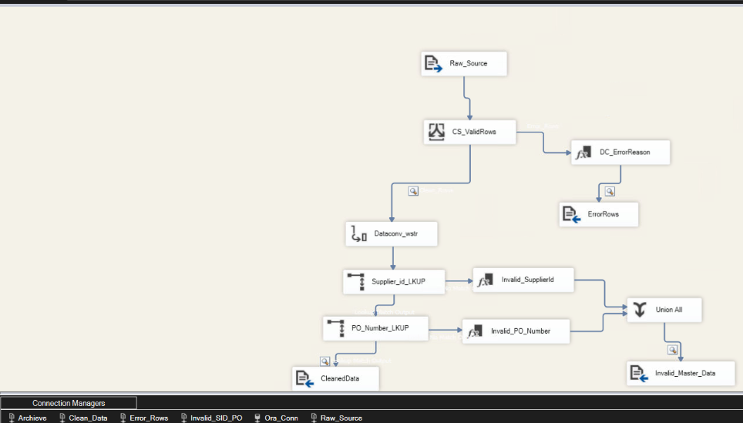
WorkFlow:

Slide 18
SSRS: Reorder Alert Report
Purpose:
Identify products that need replenishment to avoid stockouts.
Calculate the shortfall quantity for each product.
Key Columns Returned:
INVENTORY_ID – Unique identifier of inventory record
LOCATION_ID,
PRODUCT_ID,
CATEGORY – Product details
CURRENT_STOCK – Stock available at the location
REORDER_LEVEL – Minimum stock threshold
SAFETY_STOCK – Minimum safety buffer
MAX_STOCK_LEVEL – Maximum stock capacity
SHORTFALL – How much quantity is below the reorder level.

Slide 19
Logic:
Join INVENTORY_MASTER with PRODUCTS and LOCATIONS to get descriptive info
Filter only records where CURRENT_STOCK < REORDER_LEVEL
Sort by INVENTORY_ID for easy reference.
Usage:
Helps inventory managers quickly identify items needing replenishment
Can be scheduled daily/weekly to maintain optimal stock levels
Supports integration with purchase planning and alerts

Slide 20
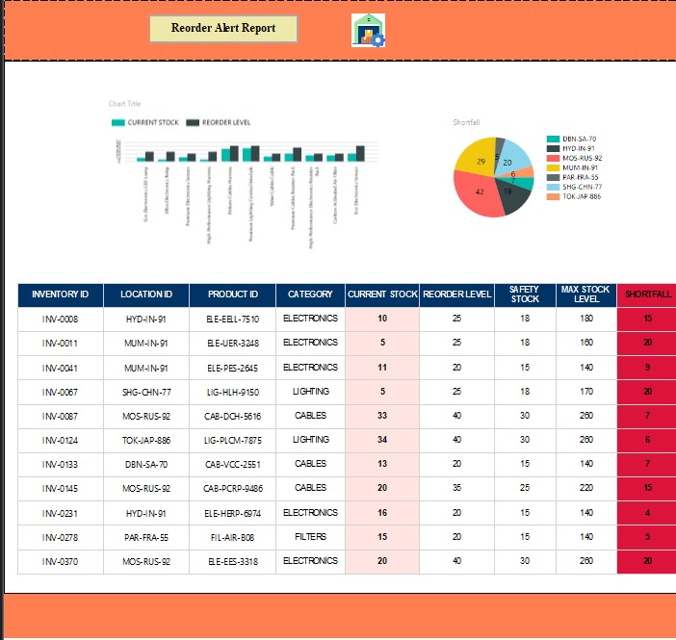
Report:

Slide 21
Executive Dashboard → KPIs and high-level metrics
Provide high-level insights and KPIs for executive decision-making
Summarize critical metrics from multiple data sources in a single view
Supports strategic decisions at executive level
Reduces manual reporting effort

Slide 22
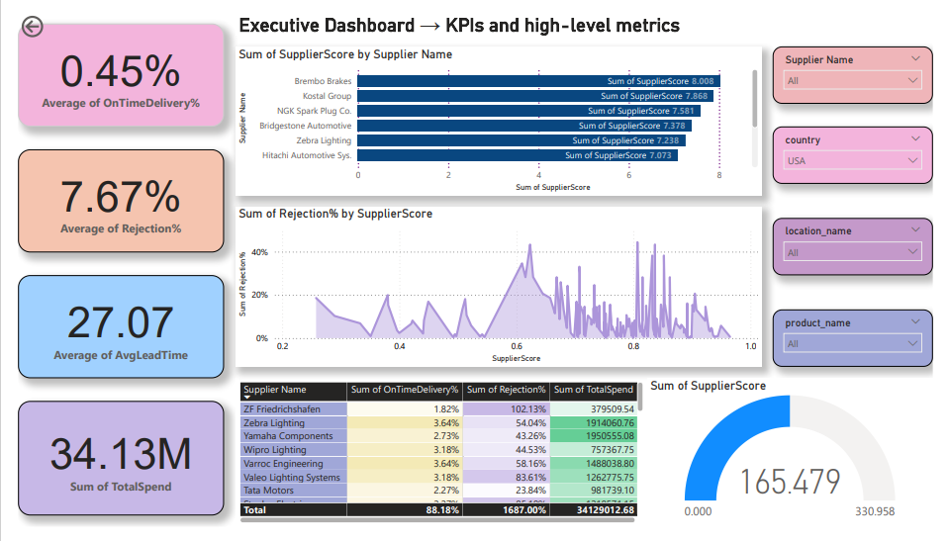
Dashboard:

Slide 23
Challenges & Solutions
Challenge | Solution
Missing or inconsistent CSV data (empty fields, wrong date formats, invalid numbers) | Used Conditional Split, ISNULL checks, Derived Columns to cleanse and validate data
Invalid Supplier IDs or PO numbers, mismatched lookup types | Standardized data types; used Lookup with error redirection; logged invalid rows separately
Errors stopped package execution; hard to trace issues | Flat file logging for row counts, file names, error reasons; redirected invalid/cleaned data to separate folders

Slide 24


Slide 25


